Slide 1
Public Education Positions &
2017 Legislative Priorities
Justin Minkel, Chair Gov. Affairs Committee
Jane West, Policy Advisor

Slide 2

EQUITY
NNSTOY believes that every student, no matter what their particular characteristics or situation, should have access to excellent teaching and the resources needed to succeed.

Slide 3
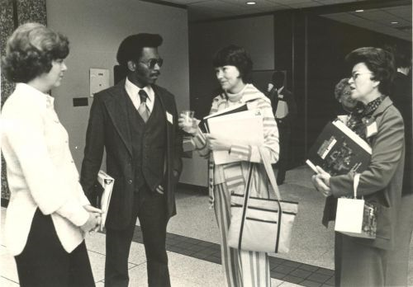
TEACHER LEADERSHIP AND POLICY
NNSTOY believes that teacher leadership is critical to the success of our nation’s schools and students.

Slide 4
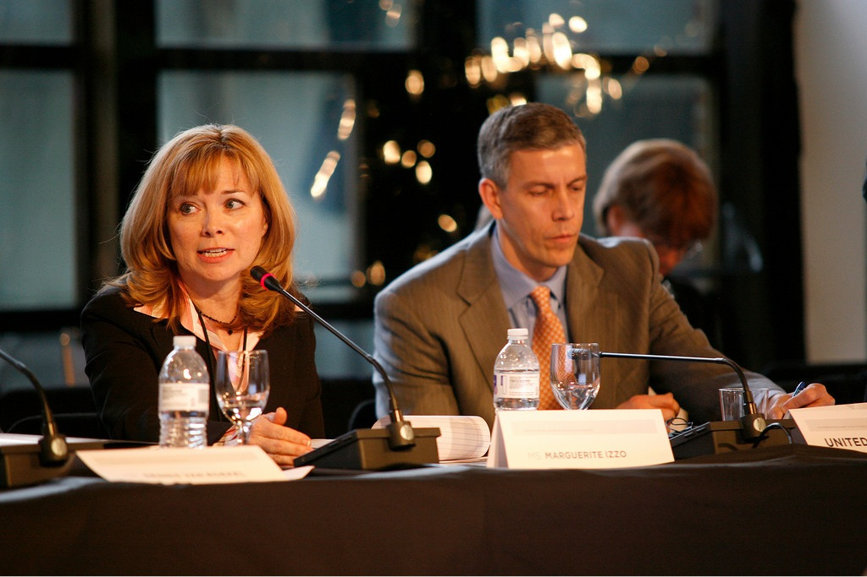

Slide 5

SCHOOL CHOICE AND VOUCHERS
NNSTOY believes that any school choice option should have the same accountability measures as traditional schools and that federal funds should not be used for vouchers.

Slide 6

SOCIAL AND EMOTIONAL LEARNING
NNSTOY believes that SEL is a critical component of education for all students.

Slide 7

2017 Legislative Priorities
APPROPRIATIONS
Continue funding for federal K-12 education programs at the current FY 2017 level or higher

Slide 8

ESSA
IMPLEMENTATION OF ESSA
Provide oversight and support to ensure robust implementation of the Every Student Succeeds Act

Slide 9

School Choice
SCHOOL CHOICE
Do not cut existing federal education programs in order to expand school choice programs.

Slide 10

Undocumented Students
EDUCATING IMMIGRANT STUDENTS WHOSE PARENTS ARE UNDOCUMENTED
Public schools should educate all students

Slide 11
Teacher Leadership:
Support These Bills
Teachers and Parents at the Table Act (H.R. 6472 in 114th Congress) -- Rep. Kathleen Rice (D-NY) and Rep. Elise Stefanik (R-NY)
Teachers as Leaders Act – S. 1413 – Sen. Chris Coons (D-DE), Sen. Joni Ernst (R-IA), Sen. Chuck Grassley (R-IA) and Sen. Jack Reed (D-RI) sponsors
The Teacher Health and Wellness Act – H.R. 2544 – Rep. Tim Ryan (D-OH) sponsor; co-sponsors: Reps. Susan Davis (D-CA), Elise Stefanik (R-NY) and Darren Soto (D-FL)
The Chronic Absenteeism and Reduction Act – H.R. 1864 – Rep. Tim Ryan (D-OH), sponsor

Slide 12
